Slide 1
Introduction to Spark Streaming with NiFi & Kafka
Robert Hryniewicz
Data Evangelist

Slide 2
Agenda
Background
Apache Spark Streaming
Apache Kafka
Apache NiFi
Demo

Slide 3
Data Flow & Streaming Fundamentals

Slide 4

Modern Data Applications Custom or Off the Shelf
Modern Data Applications
Real-Time Cyber Security protects systems with superior threat detection
Smart Manufacturing dramatically improves yields by managing more variables in greater detail
Connected, Autonomous Cars drive themselves and improve road safety
Future Farming optimizing soil, seeds and equipment to measured conditions on each square foot
Automatic Recommendation Engines match products to preferences in milliseconds
ACTIONABLE INTELLIGENCE
DATA IN MOTION
DATA AT REST
Hortonworks
DataFlow
Hortonworks
Data Platform
Notes:
TALK TRACK
Here are just a few of the modern data apps that convert yesterday’s impossible challenges into today’s new products, cures, conveniences and life saving innovations.
These apps are either custom-built by our customers or they come of the shelf, created by Hortonworks or one of of our ecosystem partners to solve a particular problem.
Symantec and other cyber security leaders have built powerful apps to detect threats to digital information.
Leading pharma, automotive, consumer electronics and packaged goods companies are building their factories of the future that use actionable intelligence to improve manufacturing yields.
And age-old industries like automotive, agriculture and retail are taking connected data platforms on the road, through the field or to the cash register to do things that have never before been possible.
[NEXT SLIDE]

Slide 5


What is Stream Processing?
Batch Processing
Ability to process and analyze data at-rest (stored data)
Request-based, bulk evaluation and short-lived processing
Enabler for Retrospective, Reactive and On-demand Analytics
Stream Processing
Ability to ingest, process and analyze data in-motion in real- or near-real-time
Event or micro-batch driven, continuous evaluation and long-lived processing
Enabler for real-time Prospective, Proactive and Predictive Analytics for Next Best Action
Stream Processing + Batch Processing = All Data Analytics
real-time (now)
historical (past)

Slide 6
Why is it Important to a Customer?
Always-on analytics enables predictive analytics
Empowers organization predict and respond in real-time to patterns and trends from the data continuously produced by devices, sensors, infrastructure and applications
Create and monetize new business models
Innovative products and services in the areas of machine analytics, customer service experience, supply chain, predictive maintenance, security and user behavioral analysis
Accelerated time-to-market
Fits seamlessly to existing IT and IoT investments, faster ROI and lower TCO
Data
Analyze
Actionable Insights
Latency (sub seconds)

Slide 7

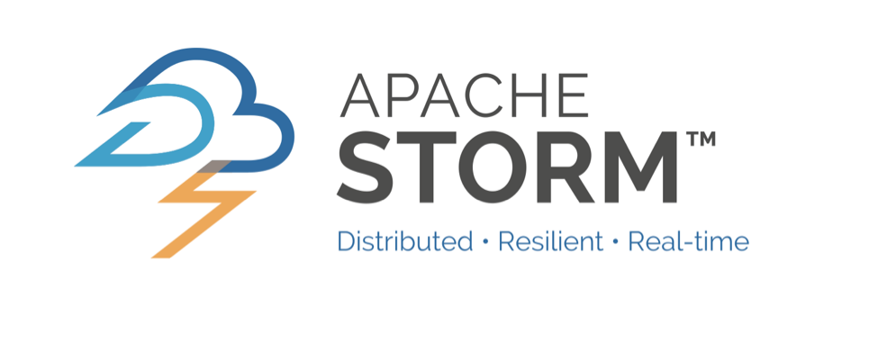
Stream Computing Illustrated
Reads Data from the Data Stream
Processes the data immediately or within a short micro-batch timeframe (e.g. <10 sec)
Can write processed data to a variety of destinations
Key use cases
Real time analytics
Online machine learning
Continuous statics computations
Operational Analytics
Filter / Sample
Data-in-Motion
Annotate
Fuse
Modify
Classify
Notes:
One way to think about what Streams computing can do for your data is to think back to innovations we've seen in the past. If you look at the industrial revolution, for example, we got very good at making things. We got better and better hardware, better and better machines, we got the invention of electricity, the invention of steam engines and so forth before that. But what really broke loose the manufacturing and made it the extremely efficient capability we have today was the assembly line technology: realizing that you can do things in a continuous way and have multiple steps along the path. And so that's really what Stream computing is bringing to you, multiple steps of processing along the path as the data's flowing in.
This chart shows just this: data comes in element by element, flows through a set of operations, like in an assembly line. For example, perhaps somebody's putting the wheels on a car, maybe somebody's bolting down the hood; these are individual operations. You may be doing filtering, you may be doing aggregation, you may be scoring against a model that's been built in BigInsights, but it's element by element, continuously passed through the infrastructure.
In Streams, in the listening step we actually are processing each and every one of them. So whatever processing has to be done or would've been done by putting it into the storage - into the database and so forth, we're doing that on the wire. And then the end result that you would - in your later downstream processing, you know, would've have been part of the (ingest) process and your downstream processing. Today, the data is (optionally) going on the disc and available for the rest of the back end infrastructure and (BI) and so forth, but it's executing the processing while it's still on the wire which gives you get tremendous efficiencies there for problems that are suited for streaming because you aren't going through the extra steps of going to disc and coming back out and maybe going to multiple steps along the stage of processing. Instead, doing it all in the continuous pipeline methodology.

Slide 8
Elements of Streaming
Ingestion
Simple Event Processing
Data Bus
Engine
Complex Event Processing
Destination
Notes:
Kafka
Reads events in memory and write to distributed log

Slide 9

Actionable Insights Architecture
Perishable Insights
Ingestion
Simple Event Processing
Data Bus
Engine
Complex Event Processing
Deploy
Predictive Model
For Real-time Insights
Destination
Build
Predictive Model
From Historical Data
Historical Insights

Slide 10
Apache Spark Streaming

Slide 11
Spark Ecosystem
Spark SQL
Spark Streaming
MLLib
GraphX
Spark Core

Slide 12
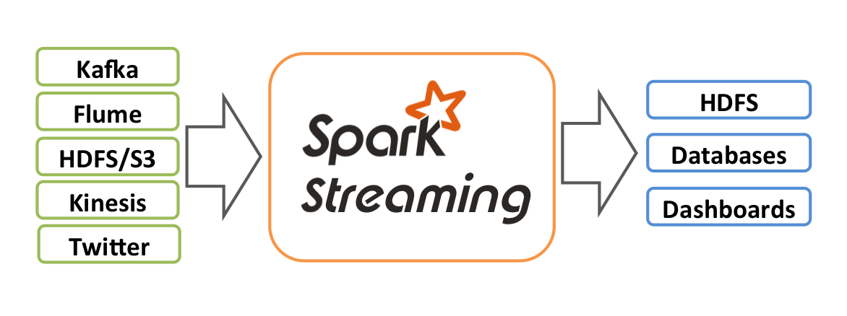
Spark Streaming
Overview
Extension of Spark Core API
Stream processing of live data streams
Scalable
High-throughput
Fault-tolerant
ZeroMQ
MQTT
Notes:
Spark Streaming is an extension of the core Spark API that enables scalable, high-throughput, fault-tolerant stream processing of live data streams. Data can be ingested from many sources like Kafka, Flume, Twitter, ZeroMQ, Kinesis, or TCP sockets, and can be processed using complex algorithms expressed with high-level functions like map, reduce, join and window. Finally, processed data can be pushed out to filesystems, databases, and live dashboards. In fact, you can apply Spark’s machine learning and graph processing algorithms on data streams.
Internally, it works as follows. Spark Streaming receives live input data streams and divides the data into batches, which are then processed by the Spark engine to generate the final stream of results in batches.

Slide 13
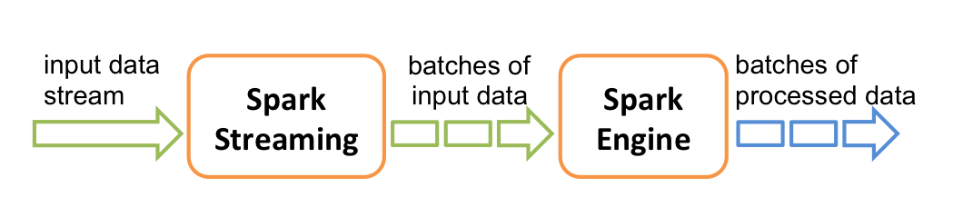
Spark Streaming

Slide 14
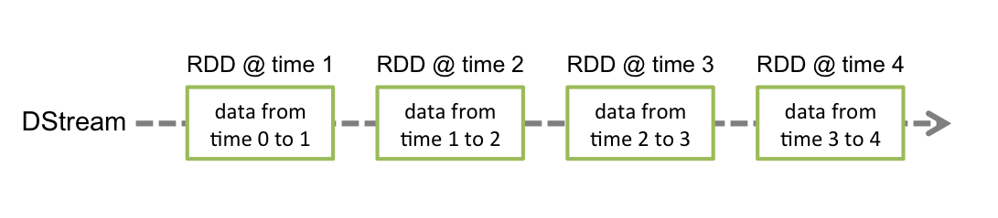
Spark Streaming
Discretized Streams (DStreams)
High-level abstraction representing continuous stream of data
Internally represented as a sequence of RDDs
Operation applied on a DStream translates to operations on the underlying RDDs
Notes:
Spark Streaming provides a high-level abstraction called discretized stream or DStream, which represents a continuous stream of data. DStreams can be created either from input data streams from sources such as Kafka, Flume, and Kinesis, or by applying high-level operations on other DStreams. Internally, a DStream is represented as a sequence of RDDs.
Discretized Stream or DStream is the basic abstraction provided by Spark Streaming. It represents a continuous stream of data, either the input data stream received from source, or the processed data stream generated by transforming the input stream. Internally, a DStream is represented by a continuous series of RDDs, which is Spark’s abstraction of an immutable, distributed dataset (see Spark Programming Guide for more details). Each RDD in a DStream contains data from a certain interval, as shown in the following figure.

Slide 15
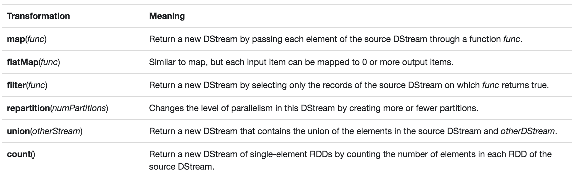
Transformations on Dstreams - 1 of 2

Slide 16
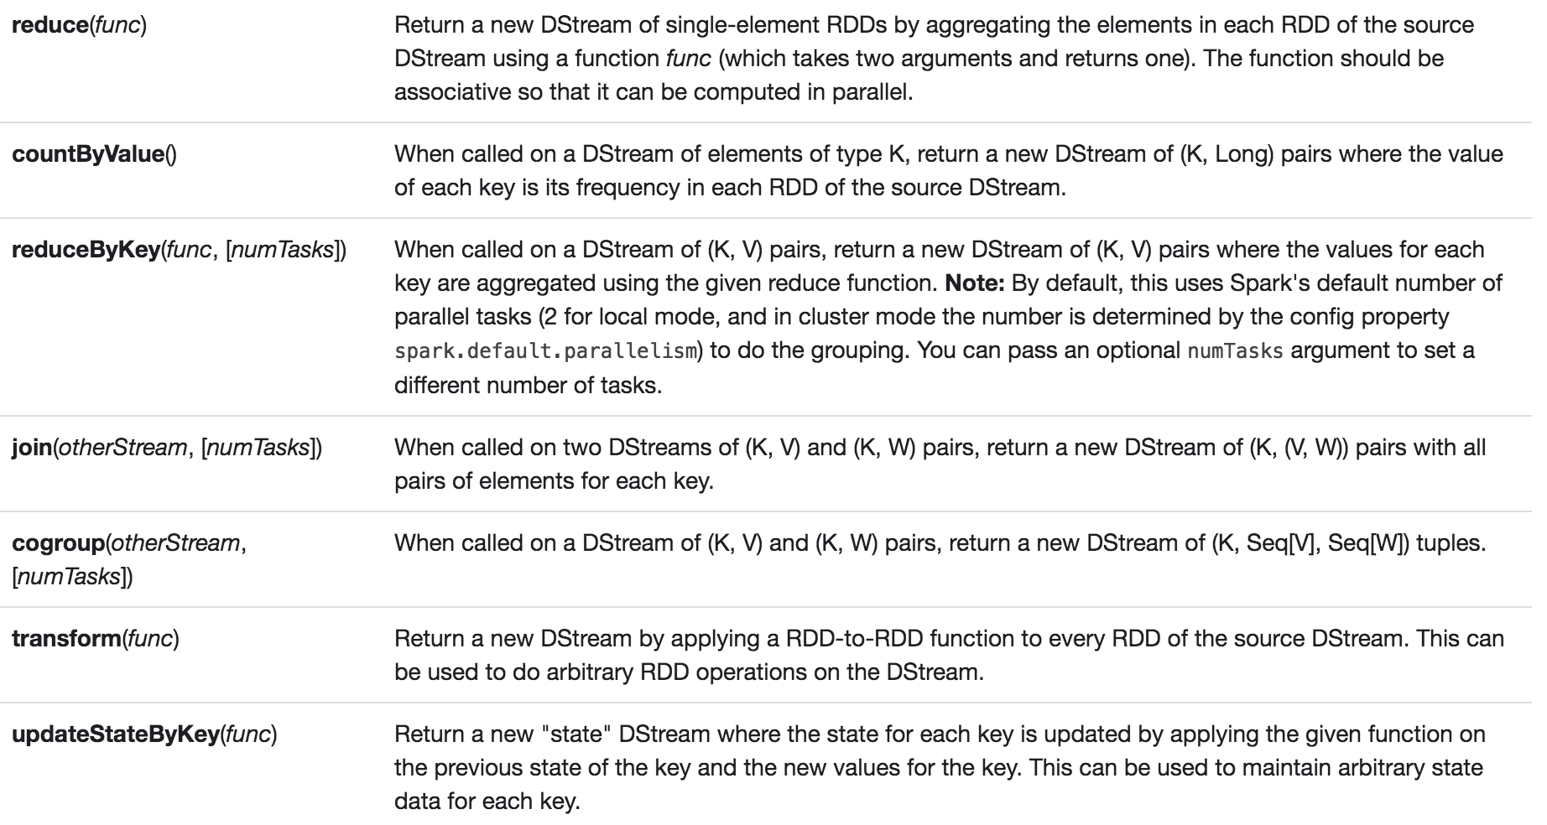
Transformations on Dstreams – 2 of 2

Slide 17
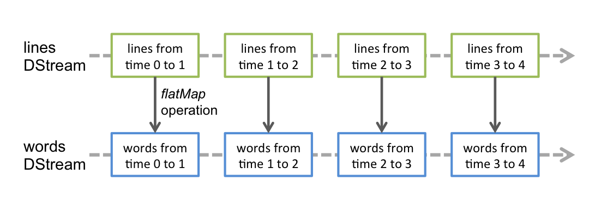
Spark Streaming
Example: flatMap operation
Notes:
Any operation applied on a DStream translates to operations on the underlying RDDs. For example, in the earlier example of converting a stream of lines to words, the flatMap operation is applied on each RDD in the lines DStream to generate the RDDs of the words DStream. This is shown in the following figure.

Slide 18
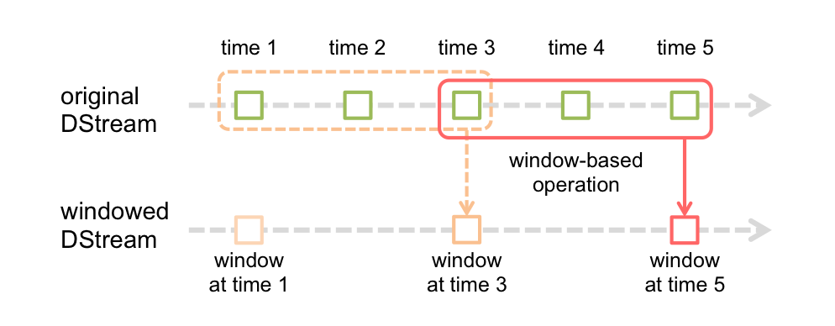
Spark Streaming
Window Operations
Apply transformations over a sliding window of data, e.g. rolling average

Slide 19
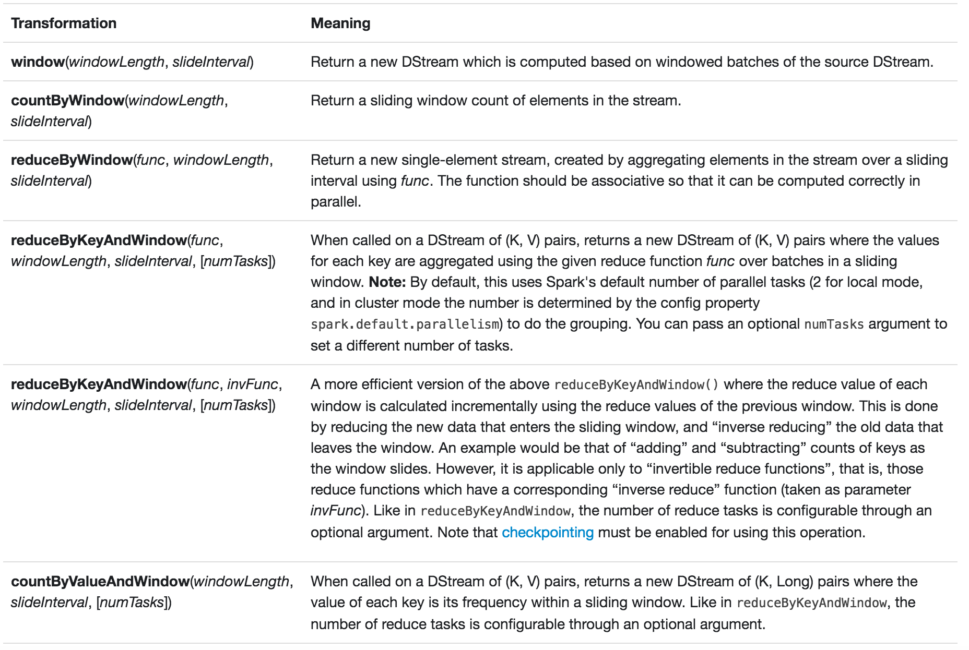
Window Transformations

Slide 20
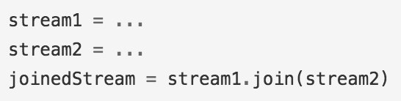
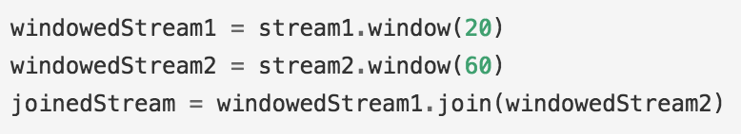
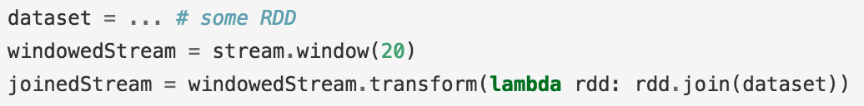
Join Operations

Slide 21
Streaming MLlib
Streaming Significance Testing (A/B Testing)
Streaming Linear Regression
Streaming K-means

Slide 22

Checkpointing
When Apps Need to Operate 24/7
Recovery from system failures, JVM failures, etc.
Metadata Checkpointing ← driver failures recovery
Data Checkpointing ← saving generated RDDs to storage
Esp. relevant when data combined across batches i.e. when generated RDDs depend on RDDs from previous batches
Checkpointing is enabled by specifying a fault-tolerant storage (HDFS, S3, …)
Notes:
A streaming application must operate 24/7 and hence must be resilient to failures unrelated to the application logic (e.g., system failures, JVM crashes, etc.). For this to be possible, Spark Streaming needs to checkpoint enough information to a fault- tolerant storage system such that it can recover from failures. There are two types of data that are checkpointed.
Metadata checkpointing - Saving of the information defining the streaming computation to fault-tolerant storage like HDFS. This is used to recover from failure of the node running the driver of the streaming application (discussed in detail later). Metadata includes:
Configuration - The configuration that was used to create the streaming application.
DStream operations - The set of DStream operations that define the streaming application.
Incomplete batches - Batches whose jobs are queued but have not completed yet.
Data checkpointing - Saving of the generated RDDs to reliable storage. This is necessary in some stateful transformations that combine data across multiple batches. In such transformations, the generated RDDs depend on RDDs of previous batches, which causes the length of the dependency chain to keep increasing with time. To avoid such unbounded increases in recovery time (proportional to dependency chain), intermediate RDDs of stateful transformations are periodically checkpointed to reliable storage (e.g. HDFS) to cut off the dependency chains.
To summarize, metadata checkpointing is primarily needed for recovery from driver failures, whereas data or RDD checkpointing is necessary even for basic functioning if stateful transformations are used.

Slide 23
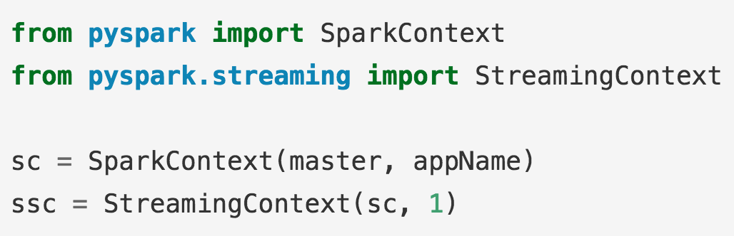
Initialize Streaming Context
Notes:
Example has a local StreamingContext with two execution threads, and batch interval of 1 second.
Points to remember
When running a Spark Streaming program locally, do not use “local” or “local[1]” as the master URL. Either of these means that only one thread will be used for running tasks locally. If you are using a input DStream based on a receiver (e.g. sockets, Kafka, Flume, etc.), then the single thread will be used to run the receiver, leaving no thread for processing the received data. Hence, when running locally, always use “local[n]” as the master URL, where n > number of receivers to run (see Spark Properties for information on how to set the master).
Extending the logic to running on a cluster, the number of cores allocated to the Spark Streaming application must be more than the number of receivers. Otherwise the system will receive data, but not be able to process it.

Slide 24
After a context is defined, you have to do the following:
Define the input sources by creating input DStreams
Define the streaming computations by applying transformation and output operations to DStreams
Start receiving data and processing it using streamingContext.start()
Wait for the processing to be stopped (manually or due to any error) using streamingContext.awaitTermination()
The processing can be manually stopped using streamingContext.stop()
Notes:
Points to remember:
Once a context has been started, no new streaming computations can be set up or added to it.
Points to remember
- Once a context has been stopped, it cannot be restarted.
- Only one StreamingContext can be active in a JVM at the same time.
- stop() on StreamingContext also stops the SparkContext. To stop only the StreamingContext, set the optional parameter of stop() calledstopSparkContext to false.
A SparkContext can be re-used to create multiple StreamingContexts, as long as the previous StreamingContext is stopped (without stopping the SparkContext) before the next StreamingContext is created.

Slide 25
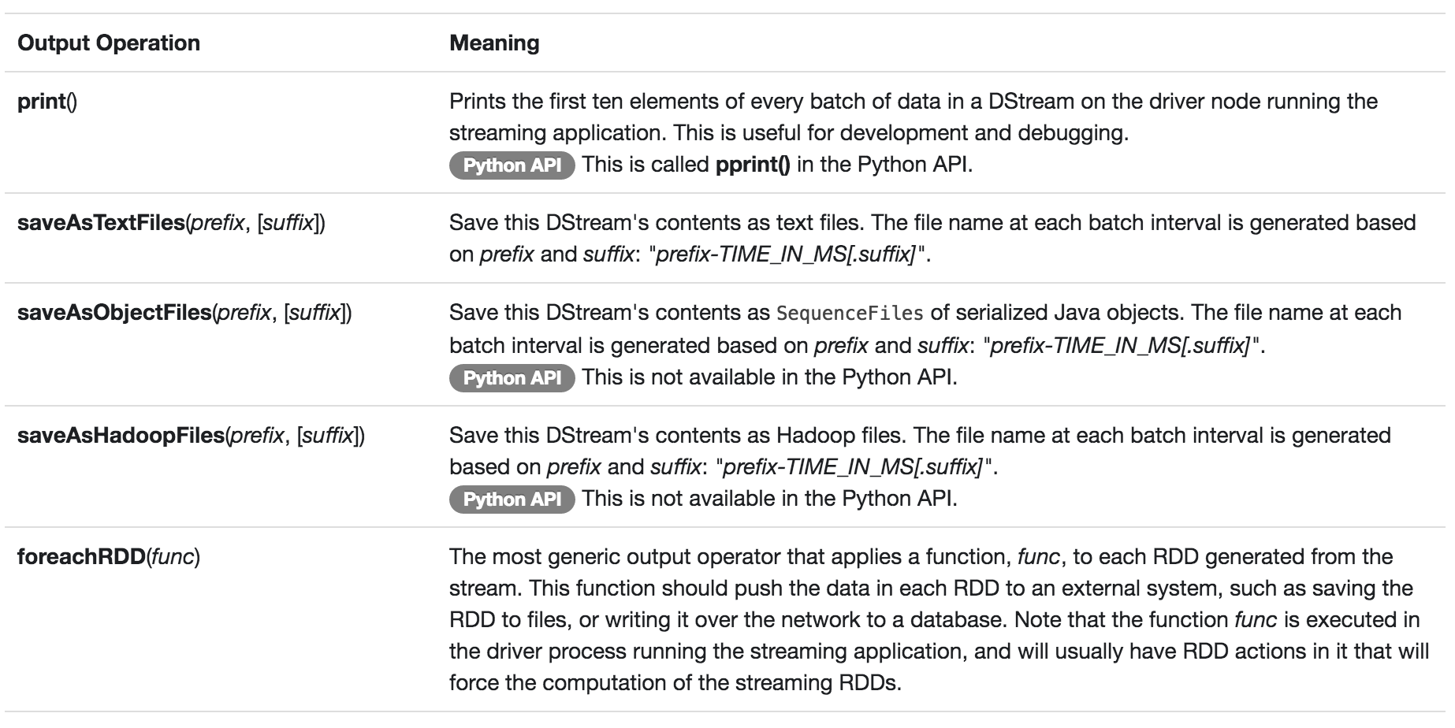
Output Operations on DStreams

Slide 26
Apache Kafka

Slide 27
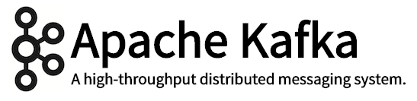
Producer 1
Broker 1
Consumer 1
Producer 2
Broker 1
Consumer 2
Producer 2
Broker 1
Consumer 3
Zookeeper

Slide 28
Apache Kafka
FAST
Single Kafka broker: 100s of MB/s read/write from 1000s of clients
SCALABLE
Single cluster as central backbone to entire organization
Elastically & transparently expanded w/o downtime
Data streams partitioned & spread over a cluster of machines
DURABLE
Messages persisted to disk & replicated to prevent data loss

Slide 29
Kafka-Spark Connector Types
Receiver Approach
Data from Kafka stored in Spark Executors
Data may be double-counted when using Write Ahead Logs for resiliency
Direct Approach (Spark 1.4+ all APIs)
Exactly-once semantics
Simplified
No need for Write Ahead Logs or Zookeeper
See Kafka Integration Guide for more info.
Use this one!
Notes:
Kafka Integration Guide: http://spark.apache.org/docs/latest/streaming-kafka-integration.html
In computer science, write-ahead logging (WAL) is a family of techniques for providing atomicity and durability (two of the ACID properties) in database systems.
In a system using WAL, all modifications are written to a log before they are applied. Usually both redo and undo information is stored in the log.
The purpose of this can be illustrated by an example. Imagine a program that is in the middle of performing some operation when the machine it is running on loses power. Upon restart, that program might well need to know whether the operation it was performing succeeded, half-succeeded, or failed. If a write-ahead log is used, the program can check this log and compare what it was supposed to be doing when it unexpectedly lost power to what was actually done. On the basis of this comparison, the program could decide to undo what it had started, complete what it had started, or keep things as they are.

Slide 30
import sys
from pyspark import SparkContext
from pyspark.streaming import StreamingContext
from pyspark.streaming.kafka import KafkaUtils
sc = SparkContext(appName="kafkaTest")
ssc = StreamingContext(sc, 5)
kvs = KafkaUtils.createStream(ssc, "localhost:2181", "spark_streaming", {"inter_transact": 1})
# APPLY OTHER TRANSFORMATIONS HERE
kvs.pprint(10)
ssc.start()
ssc.awaitTermination()

Slide 31
Apache NiFi

Slide 32



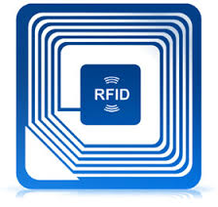




Data Sources
What generates data?
Internet of Anything (IoAT)
Wind Turbines, Oil Rigs, Cars
Weather Stations, Smart Grids
RFID Tags, Beacons, Wearables
User Generated Content (Web & Mobile)
Twitter, Facebook, Snapchat, YouTube
Clickstream, Ads, User Engagement
Payments: Paypal, Venmo

Slide 33
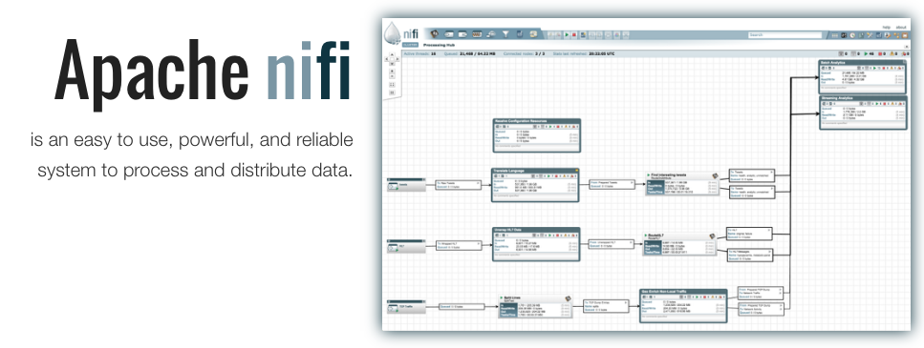
Notes:
NiFi is used to push messages, and not store messages; it will crash if it will keep storing data in it.

Slide 34
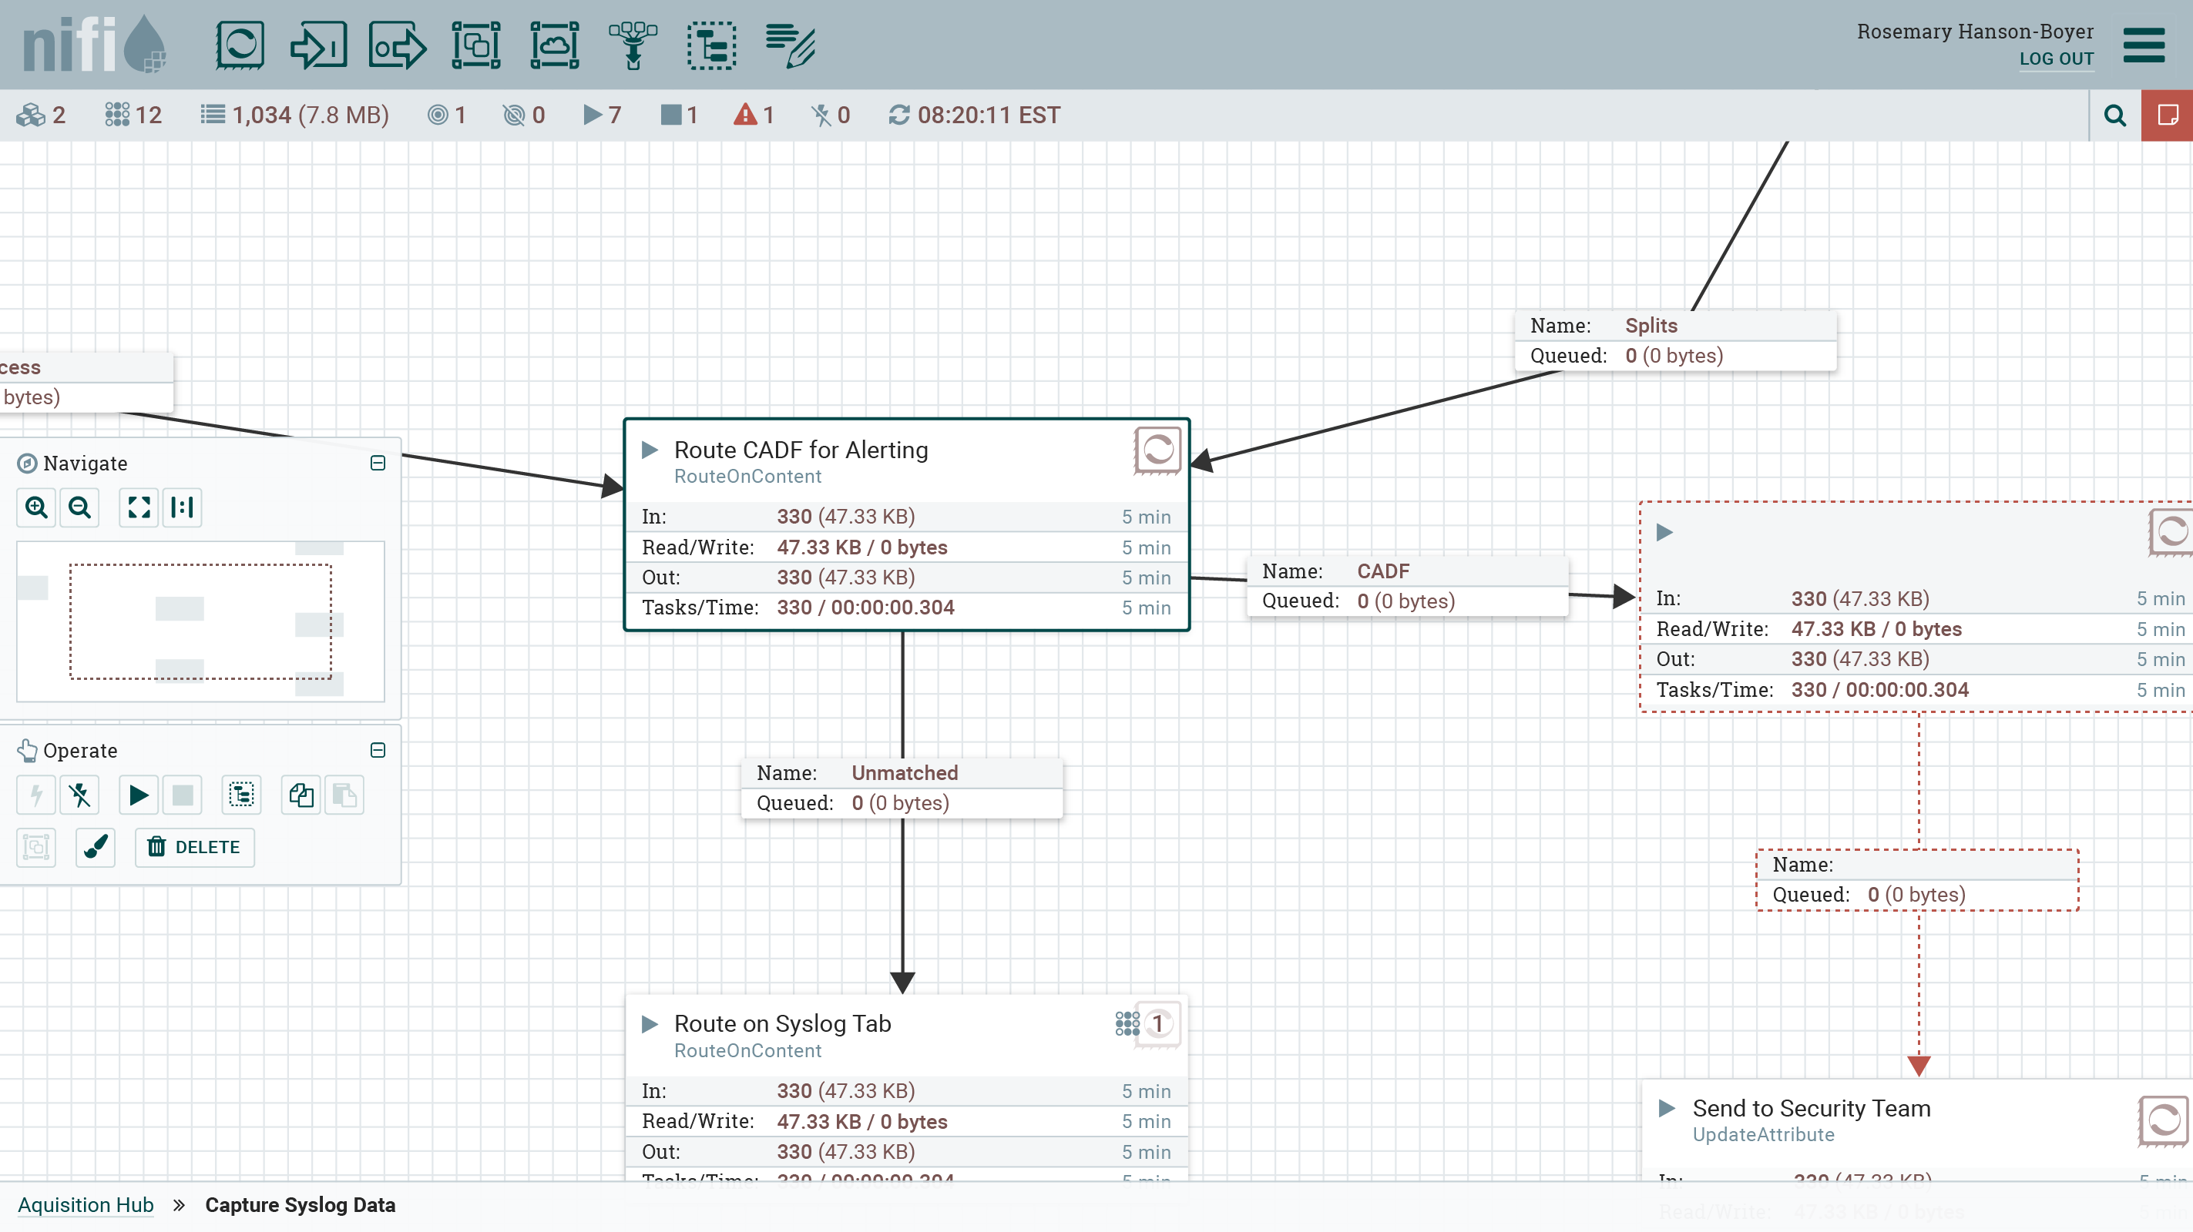
Apache NiFi High Level Capabilities
Web-based user interface
Design, control, feedback & monitoring
Highly configurable
Loss tolerant vs guaranteed delivery
Low latency vs high throughput
Dynamic prioritization
Flow can be modified at runtime
Back pressure
Data provenance
Track dataflow from beginning to end
Designed for extension
Build your own processors
Secure
SSL, SSH, HTTPS, etc.

Slide 35
Data Agnosticism
NiFi is data agnostic!
But designed to interact with specific formats, protocols, etc.
Almost 180 Processors
HDFS, S3
Kafka, Kinesis
HTTP, FTP, SFTP, TCP, UDP
XML, JSON
SQL, Mongo, DynamoDB,
HBase, Cassandra
Twitter
MQTT, AMQP
Etc.
ISO 8601 - http://xkcd.com/1179/

Slide 36

Apache NiFi Subproject: MiNiFi
Let me get the key parts of NiFi close to where data begins and provide bidrectional communication
NiFi lives in the data center. Give it an enterprise server or a cluster of them.
MiNiFi lives as close to where data is born and is a guest on that device or system

Slide 37


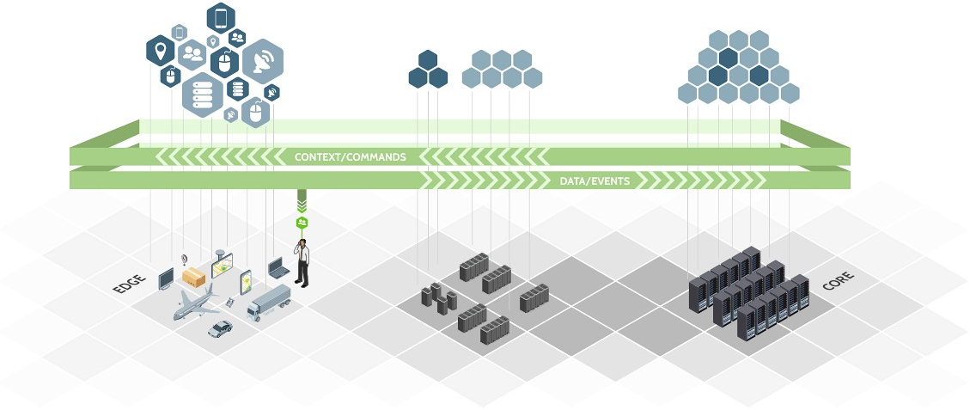
Apache NiFi Managed Dataflow
SOURCES
REGIONAL INFRASTRUCTURE
CORE INFRASTRUCTURE

Slide 38
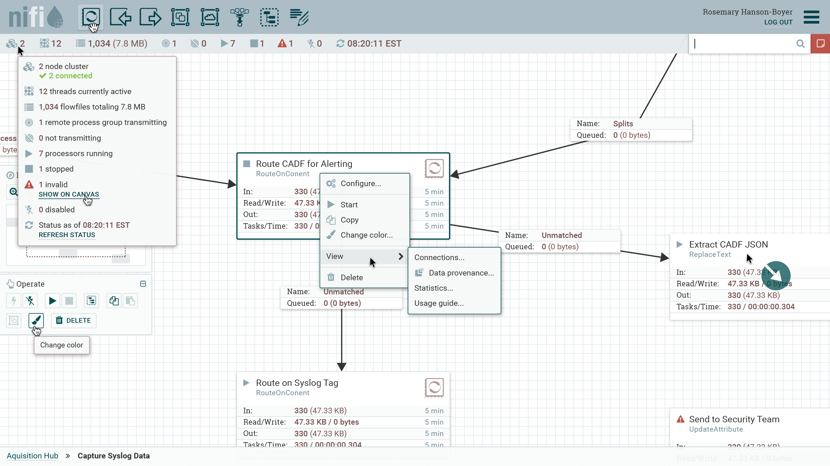
Notes:
New NiFi UI mockups: https://issues.apache.org/jira/browse/NIFI-1323

Slide 39
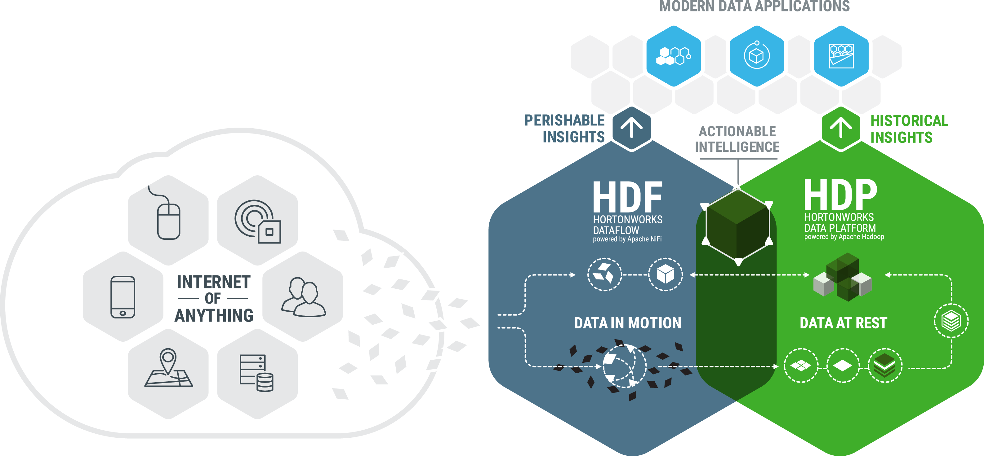
The Connected Data Platform
DEMO
Notes:
Talk Track:
HDF and HDP are part of an enterprises connected data platforms – data is part of every organization, every project, every line of business.
Data in Motion (connected, real-time, tracked) and Data at Rest (massive scale analysis, retention, security)

Slide 40



DEMO

Slide 41
Do It Yourself Instructions
http://tinyurl.com/hwx-intro-to-spark-streaming

Slide 42
Thanks! T: @RobHryniewicz E: rhryniewicz@hortonworks.com

Slide 43
Extra Slides

Slide 44
Receiver Reliability
Reliable Receiver - correctly sends acknowledgment (ack) to a reliable source when the data has been received and stored in Spark with replication.
Unreliable Receiver - does not send acknowledgment to a source
Typical for sources where:
No support for acknowledgments
No need
Notes:
There can be two kinds of data sources based on their reliability. Sources (like Kafka and Flume) allow the transferred data to be acknowledged. If the system receiving data from these reliable sources acknowledges the received data correctly, it can be ensured that no data will be lost due to any kind of failure. This leads to two kinds of receivers:
Reliable receivers
Unreliable receivers

Slide 45
Approach 1: Receiver Approach
Implemented using Kafka high-level consumer API
Data received from Kafka stored in Spark executors
Under default config can loose data
To ensure zero-data loss enable Write Ahead Logs (at least-once semantics)
Saves data to distributed file system HDFS, S3,…
But data replicated twice... once by Kafka & once by Write Ahead Log

Slide 46
Approach 2: Direct Approach (No Receivers)
Use this one!
Available since Spark 1.3 (Python API since Spark 1.4)
Ensures stronger end-to-end guarantees
Periodically queries Kafka for new data (latest offsets in each topic & partition) and then defines offset ranges to process in each batch
Advantages over approach 1 (i.e. Receiver based)
Simplified Parallelism
No need to create multiple input Kafka streams & union them
One-to-one mapping between RDD partitions and Kafka partitions to consume
Easier to understand & tune
Efficiency – no need to store data in a Write Ahead Log
Messages can be recovered from Kafka
Exactly-once semantics (each record received exactly once)
Does not use Zookeeper
eliminated inconsistencies between Spark Streaming and Zookeeper/Kafka
Notes:
Simplified Parallelism: No need to create multiple input Kafka streams and union them. With directStream, Spark Streaming will create as many RDD partitions as there are Kafka partitions to consume, which will all read data from Kafka in parallel. So there is a one-to-one mapping between Kafka and RDD partitions, which is easier to understand and tune.
Efficiency: Achieving zero-data loss in the first approach required the data to be stored in a Write Ahead Log, which further replicated the data. This is actually inefficient as the data effectively gets replicated twice - once by Kafka, and a second time by the Write Ahead Log. This second approach eliminates the problem as there is no receiver, and hence no need for Write Ahead Logs. As long as you have sufficient Kafka retention, messages can be recovered from Kafka.
Exactly-once semantics: The first approach uses Kafka’s high level API to store consumed offsets in Zookeeper. This is traditionally the way to consume data from Kafka. While this approach (in combination with write ahead logs) can ensure zero data loss (i.e. at-least once semantics), there is a small chance some records may get consumed twice under some failures. This occurs because of inconsistencies between data reliably received by Spark Streaming and offsets tracked by Zookeeper. Hence, in this second approach, we use simple Kafka API that does not use Zookeeper. Offsets are tracked by Spark Streaming within its checkpoints. This eliminates inconsistencies between Spark Streaming and Zookeeper/Kafka, and so each record is received by Spark Streaming effectively exactly once despite failures. In order to achieve exactly-once semantics for output of your results, your output operation that saves the data to an external data store must be either idempotent, or an atomic transaction that saves results and offsets (see Semantics of output operations in the main programming guide for further information).

Slide 47
Demo Help

Slide 48
Demo Commands
NiFi: 127.0.0.1:9090/nifi
Shell: 127.0.0.1:4200
Start Spark Streaming
# cd /root/nifi_spark_streaming_demo
# sh kafka_test.sh
Check logs
# hadoop fs -ls /user/nifi/raw_logs/ | sort -k6,7
Check sample log
# hadoop fs -cat /user/nifi/raw_logs/313708703806190

